Slide 1
Capstone Project - Restaurant Opening in NYC
By Raheel Syed May 16, 2019

Slide 2
Problem Statement
Determine the best neighborhoods in NYC to open a new restaurant for any particular theme/cuisine
View a map of current restaurants within new york city neighborhoods to analyze saturation

Slide 3
Data Aquisition
New York City Neighborhoods
Source : https://cocl.us/new_york_dataset
json data set contains the neighborhood information including Boroughs, Neighborhoods, and geographic coordinates (latitude and longitude)
Foursquare API
Retrieve list of restaurant venues for pre-selected cuisine categories for restaurants in NYC neighborhoods

Slide 4
Methodology
Load NYC Neighborhood Data
Get Restaurants Nearby from Foursquare API
Clean Data for applying k-Means model
Apply k-Means iteratively to find optimal solution
Fit k-Means model and display map output

Slide 5
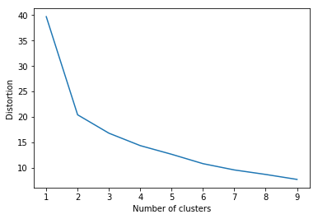
Segmentation Model
Below is the elbow curve showing optimal clusters are 2 for modeling the pre-selected restaurant venues

Slide 6
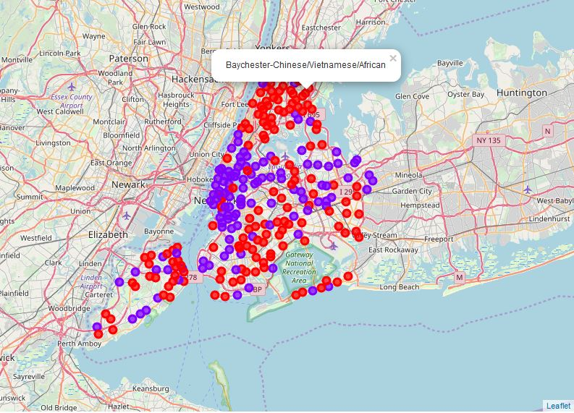
NYC Map with Restaurants Overlayed

Slide 7
Results & Conclusion
We are able to see based on the limited restaurant categories we selected, in this case two clusters created the optimal segmentation as displayed above.
Neighborhoods in cluster 1 tend to have a higher ratio of Chinese,Vietnamese and African restaurants as compared to other neighborhoods.
It may be better to avoid starting a new chinese restaurant in say, Baychester, since there is already high saturation in that vicinity

Slide 8
Limitations
Below are some of the limitations with this analysis which can be further studied with a more in-depth analysis to better determine restaurant segmentation for general search as well as for a guideline for deciding where to open a new cultural restaurant:
Taking into account user reviews such as from Yelp may help to get a better feel of what are the locations with the most popular restaurant venue types
Expand on the list of restaurant categories to consider for inclusion in initial data retrieval from Foursquare API
Add additional features to better form clusters such as demographic/population information for each neighborhood, income, etc.

